Slide 1
Welcome UCS Students!
Hyland Coding Workshop
Please follow these instructions:
Turn on your webcam if you have one
Make sure your Zoom name is your real name
Connect to audio via your computer or phone
If you’re using two devices, join Zoom from each one
HAVE FUN!

Slide 2
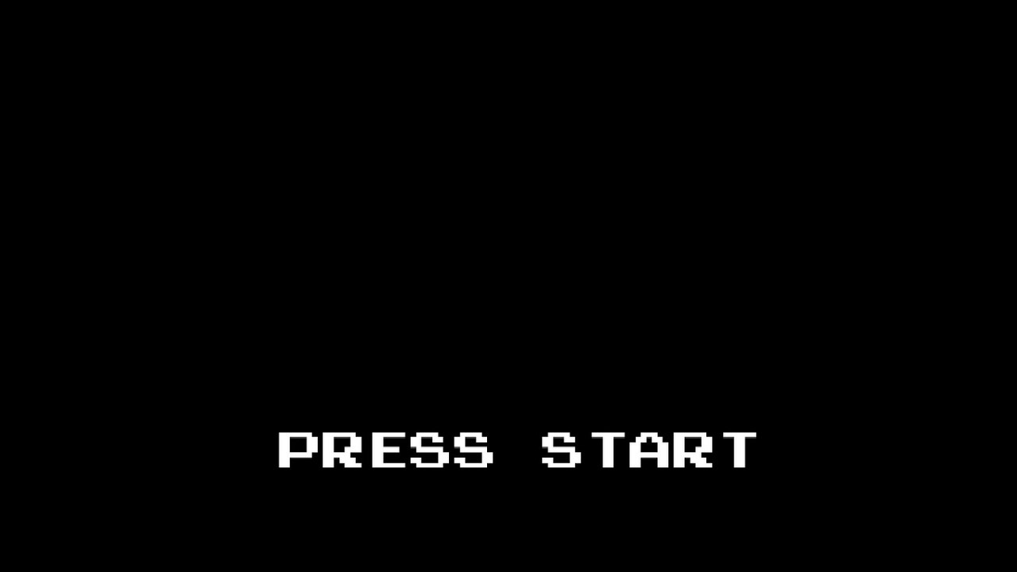


Slide 3


Slide 4
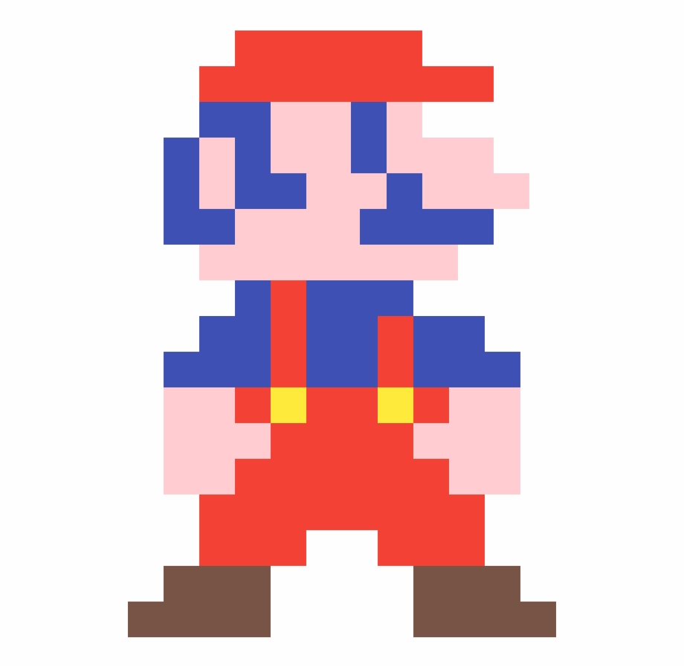
What are some examples of retro games?
Notes:
Ask the students for examples of retro games they may have played.
e.g. Kirby, sonic, Zelda, mega man, many others!
One of the most famous retro game characters is Mario.

Slide 5
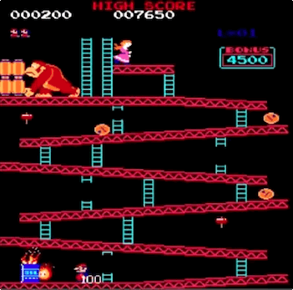
Donkey Kong (1981)
Arcade game
Shigeru Miyamoto & Gunpei Yokoi
First story-driven game ever!
Inspired by Popeye, King Kong
Groundbreaking graphics
The hero was Mr. Video / Jumpman
Would later become known as Mario
Notes:
In 1981, Nintendo released Donkey Kong. At this point, video games were really starting to take shape, and Donkey Kong was incredibly important in this developing industry.
Donkey Kong was an arcade game – it required a huge cabinet for all the hardware. Ask the students if they have ever played a physical arcade game
Shigeru Miyamoto & Gunpei Yokoi developed the game – Shigeru Miyamoto went on to be one of Nintendo’s most prolific developers
It was the first story driven game ever!
It was inspired by Popeye, King Kong, and Beauty & the Beast
While the graphics look extremely outdated now, they were groundbreaking at the time
The main character was originally named Mr. Video, and then Jumpman, before finally becoming the character we all know and love.

Slide 6
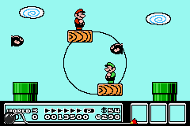
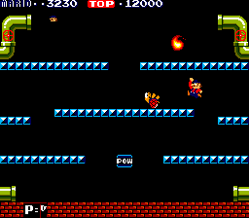
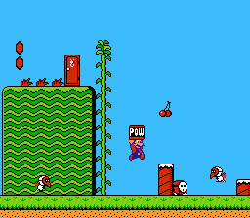
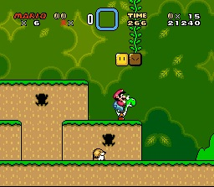
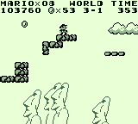
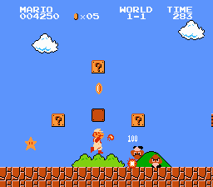
Mario’s Early Games
NES
NES
Arcade
SNES
GAMEBOY
NES
Notes:
Mario would go on to appear in several video games.
Here we have:
Mario Bros (arcade game)
Super Mario Bros (NES)
Super Mario Bros 2 (NES)
Super Mario Bros 3 (NES)
Super Mario Land (Gameboy)
Super Mario World (Super Nintendo)
What do these games all have in common? They are all examples of platformers.

Slide 7
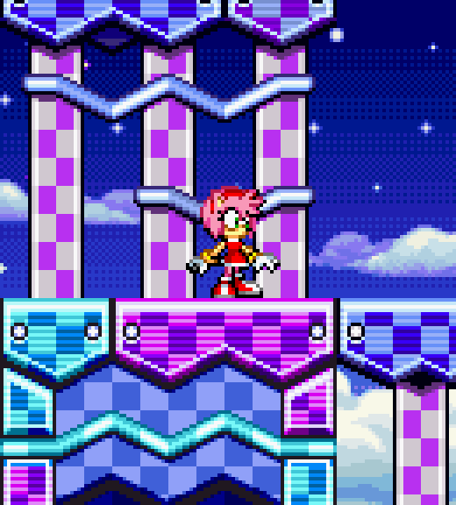

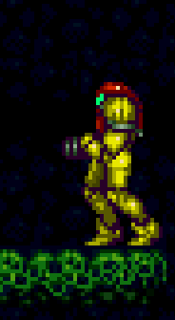
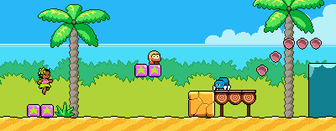
Platformers
Notes:
Back in the day, one of the most popular types of video game was a platformer. Ask the students to name any platformers they may have played.
These games are:
Sonic
Kirby
Metroid
Leilani’s Island (a modern indie game – using the retro style!)

Slide 8
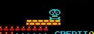
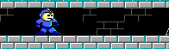
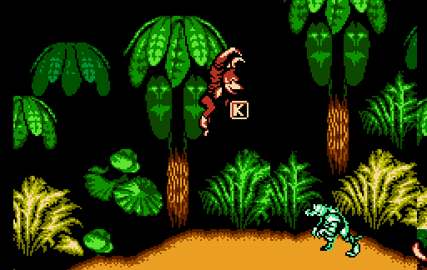
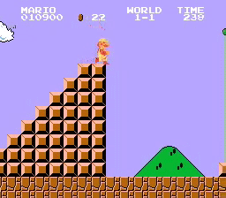
Traditional 2D Platformer Features
Obstacles and Enemies
Jumping
Horizontal Movement
Win at Map’s Edge
Notes:
What makes a platformer a platformer? Ask the students if they know, then reveal four of the main traits for a 2D platformer.

Slide 9
How can a developer make a platformer?
Notes:
Ask the students if they are familiar with any ways developers can make games.

Slide 10
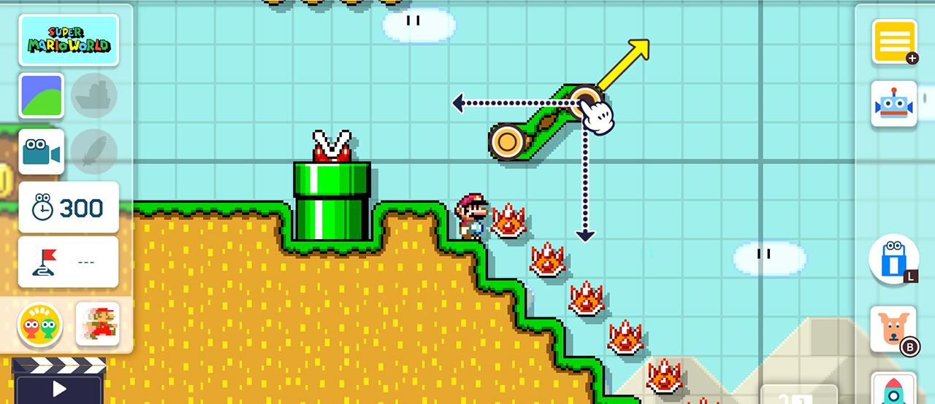
Making a Game – No Code
Notes:
Nowadays, it’s pretty easy to make a game using something like Super Mario Maker. There are other online tools for making platformer games.
However, to make a more customized game, it is necessary to use code.

Slide 11
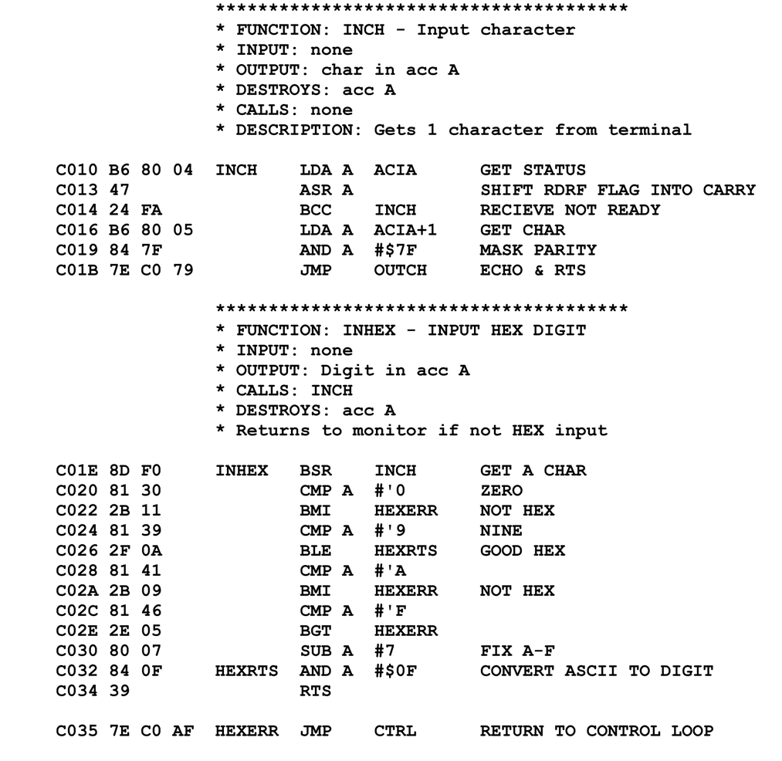
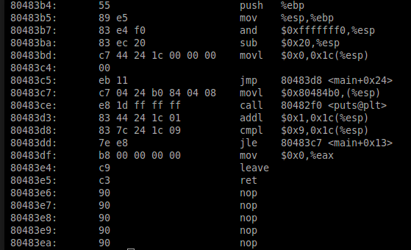
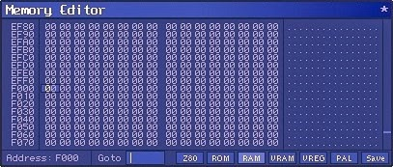
Making a Game the Old Way – Assembly / Machine Code
Notes:
The original developers of platformer games had to write a whole lot of code to make the games they made! They used a lot of low-level assembly languages to program the game cartridges and arcade cabinets with entire games.
This code is almost completely indecipherable, but the developers knew what all of it meant!
In modern times, there are many options for creating games using a variety of programming languages.

Slide 12
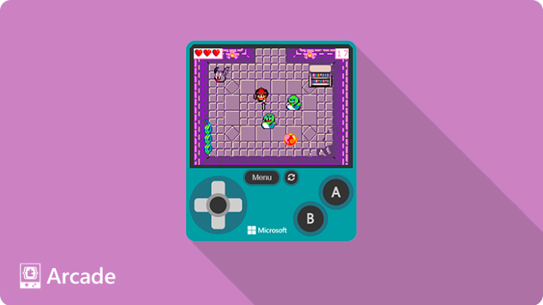
Microsoft MakeCode Arcade
Free
Open-source
Retro games
Block-based language
Handheld output
Tutorials available
Notes:
Microsoft’s MakeCode Arcade is a free game development platform used to make retro games with a block-based language. It’s a good way start learning how to code while making a game!

